Slide 1
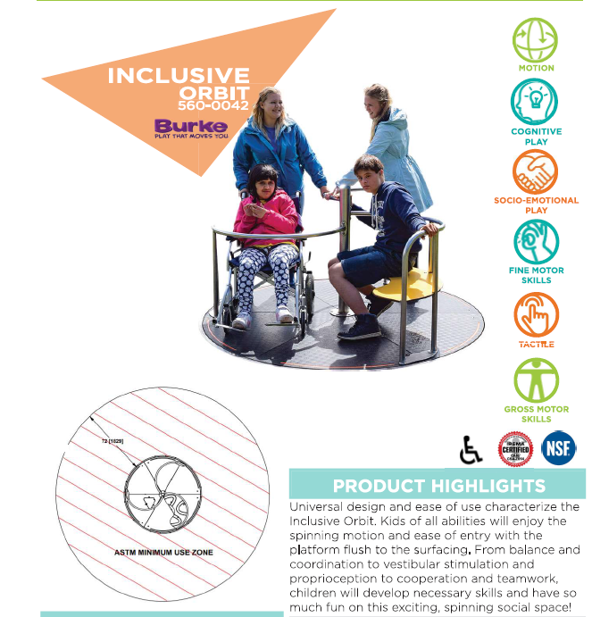
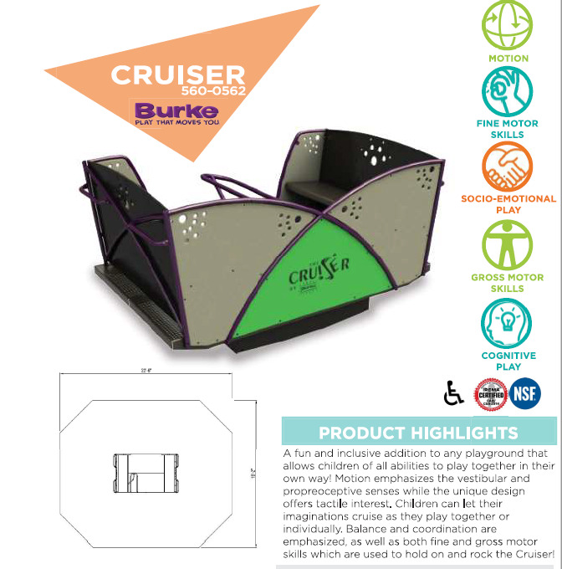
Inclusive Playground Addition at Jennie Emery
Why? To incorporate inclusive playground structures that involve motion play
What? Two pieces of playground equipment and an additional ramp

Slide 2
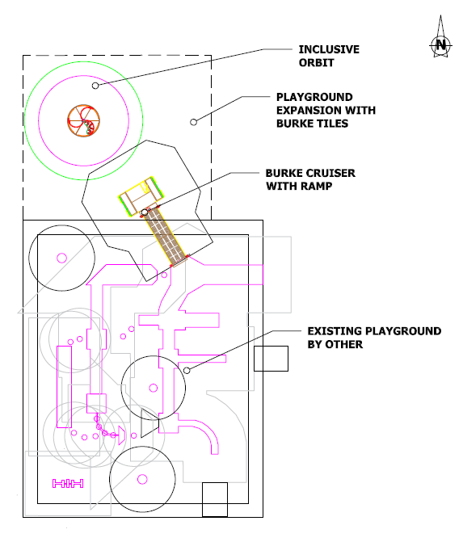

Where? Between the two existing playgrounds
When? We are hopeful in receiving a provincial grant that will complete our fundraising. If we receive this funding, we can complete this project early summer of 2024.

Slide 3
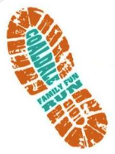


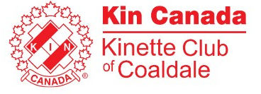




Who? Thank you to the following sponsors who donated over $1000:
Coaldale Fun Run
Coaldale Community Wellness Fund
Kinsmen Club of Coaldale
Kinette Club of Coaldale
Town of Coaldale Community Grant
Community Foundation of Lethbridge and Southwestern Alberta
“Friends of Jennie Emery Elementary Society gratefully acknowledges the financial support of the Community Foundation of Lethbridge and Southwestern Alberta, a public foundation serving the community of Southwestern Alberta.”
Friends of Jennie Emery Elementary Society
Kasko Cattle

